Slide 1

PARSE TREE GENERATION
BY ANTLR TOOL
PRESENTED BY:
NASIF WASEK FAHIM
ID: 2017-1-60-037
MD. RAJIB HAWLADER
ID: 2017-1-60-104
EAST WEST UNIVERSITY , BANGLADESH

Slide 2
PARSE TREE GENERATION
A parse tree or parsing tree or derivation tree or concrete syntax tree is an ordered, rooted tree that represents the syntactic structure of a string according to some context-free grammar.
In this project we used ANTLR tool as parse tree generator.

Slide 3
OUR GRAMMAR
grammar compiler;
root: header_file mainfunction;
header_file: '$' text;
text: 'Start';

Slide 4
GRAMMAR CONTINUES…
mainfunction: 'mainfunction:' content;
content: '['inside_main']';
inside_main: (statement)+;
statement: expression
|ID '=' expression
|ID '++'
|ID '--'
|if_condition
|loop
;

Slide 5
GRAMMAR CONTINUES…
expression: expression('*'|'/') expression
| expression ('+'|'-') expression
|INT
|ID
| '(' expression ')'
;

Slide 6
GRAMMAR CONTINUES…
if_condition: 'jodi' '('condition')' '[' (statement)* ']';
loop: 'loop' '('condition')' '[' (statement)* | 'break' ']';
condition: ID relational_op expression;
relational_op:'>'|'<'|'>='|'=='|'<='|'!=';
INT:[0-9]+;
WS : [ \r\n\t]+ -> skip ;
ID:[a-z|A-Z]+;

Slide 7
INPUT
$ Start
mainfunction:
[
jodi(a >4)
[
a = 30 * 4
b = a + (10*8)
]
loop(x>11)
[
x=x+5
x++
jodi(x == 50)
[
break
]
]
jodi(b<14)
[
x = 78
]]

Slide 8
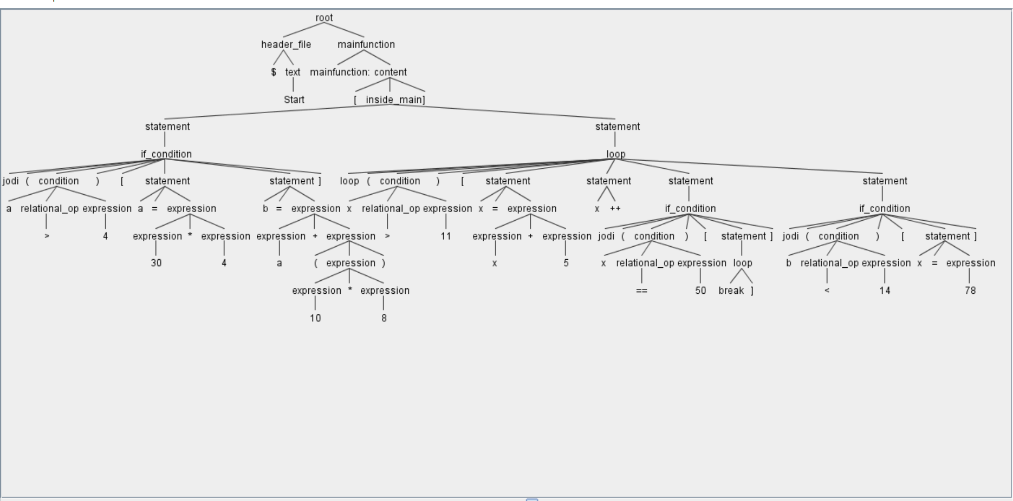
PARSE TREE OF INPUT

Slide 9
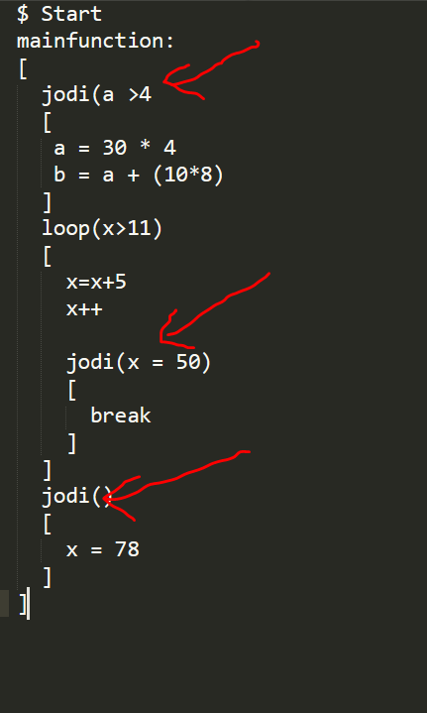
INPUT WITH ERROR

Slide 10
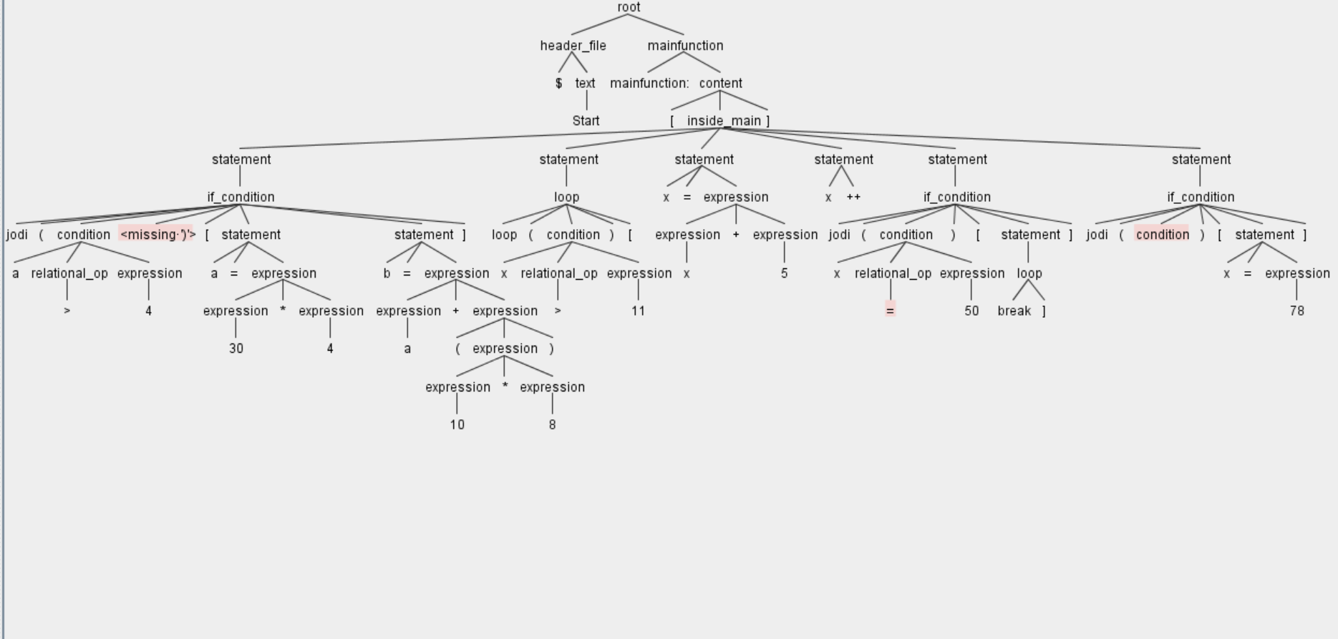
ERRORS SHOWN IN TREE

Slide 11
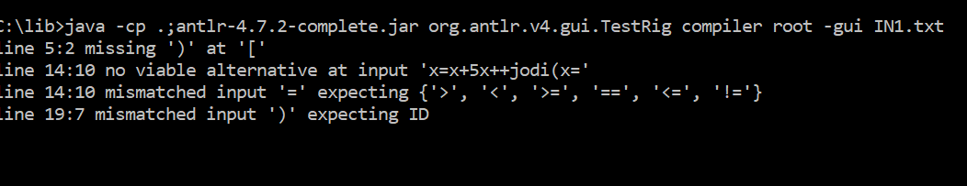
ERRORS SHOWED IN CMD

Slide 12

Questions & Suggestions

Slide 13
Thank you

